Slide 1
5G introduction Presentation of the documents

Slide 2
« The Splinternet of Things Threatens 5G’s Potential » The Economist, 25 December 2019
Document 1
Se briser / voler en éclat
Une écharde
Faire voler en éclats
= meaning of the pun?

Slide 3
Main arguments
Document 1
Operators are deploying 5G networks worldwide.
China and Huaweï: leaders
Geopolitical and technical obstacles to a fast deployment
Global divide over 5G, nicknamed Digital Berlin Wall

Slide 4
Presentation of document 1

Slide 5
An opinion piece published in The Economist on December, 25th 2019, warns against the geopolitical and technical obstacles to 5G’s success—using a pun « splinternet ».

Slide 6
« UK Should Revisit Ban Now Trump Is Defeated, Says Huawei » The Guardian, 20 November 2020
Document 2
The THE in front of UK is omitted because it’s a title, and certain articles are usually left out in titles – DO NOT DO THIS. 😊 (see RDJ) In this article, the argument is made by Huawei’s vice-president = obvious bias.

Slide 7
Main arguments:
Document 2
China is asking the UK to reconsider the ban on Huawei
The ban will delay the deployment of 5G across the UK = detrimental effects on the British economy
The UK needs 5G to remain a leader in
Innovation.
Yet: fears of spying

Slide 8
Presentation of document 1

Slide 9
Document 2
In a 2020 Guardian report, Huawei’s vice-president gives a biased explanation about why the UK should accept this 5G giant provider.

Slide 10
"5G conspiracy theory threatens economies and risks leaving people with slow connections, EU countries warn", The Independent, October 19 2020
Document 3
Same remark concerning « the »
IndependEnt

Slide 11
Main arguments:
Document 3
Some people believe that Electro Magnetic Field (EMF) radiations are a health hazard (although there is no scientific proof)
Arson attacks on 5G masts worldwide.
The EU is trying to tackle such theories to prevent adverse/negative economic effects.

Slide 12
Presentation of the document

Slide 13
Document 3
A report issued/published/released in The Independent on October, 19th 2020, sheds light on the EU’s management of conspiracy theories regarding 5G.

Slide 14
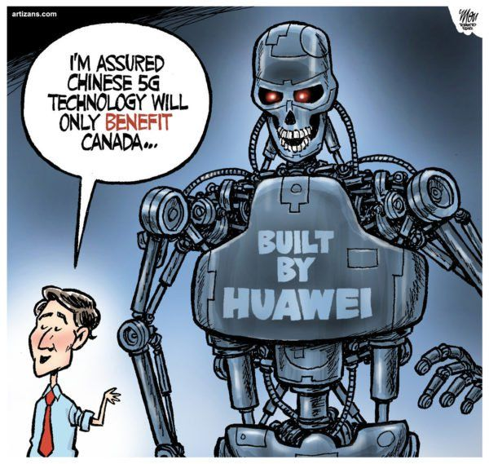
CARTOON Newswatch.com, December 2018
Document 4

Slide 15
Main arguments
Document 4
a tiny / childish / meek (humble / docile) Canadian PM embodying innocence next to a nasty-looking giant robot built by Huawei
nasty-looking because: piercing eyes, Terminator-like, shape of a skull + it is looming over Justin Trudeau (= se dresse au-dessus de JT de façon intimidante)

Slide 16
Document 4
Discrepancy (écart / grande différence) between what Trudeau says and the look of the robot = irony
= The nations dealing with the Chinese are considered naive (in the other documents: they are considered so by the US and its allies).

Slide 17
Document 4
Huawei is seen as a weapon of war,
a Trojan horse (= something that appears harmless or beneficial but is actually dangerous or deceptive) used by China to take control over the rest of the world.

Slide 18
Presentation of document 4

Slide 19
A cartoon from Newswatch.com released in December 2018, ironically questions Canada’s decision to buy Huawei’s 5G technology.

